Slide 1

Computer Engineering Department
A.P. Shah Institute of Technology
G.B.Road,Kasarvadavali, Thane(W), Mumbai-400615
UNIVERSITY OF MUMBAI
Academic Year 2020-2021

Slide 2
A Mini Project Report on
EXPENSE MANAGER
Submitted in partial fulfillment of the degree of
Bachelor of Engineering(Sem-IV)
in
Computer Engineering
By
Rakshit Shah (19102008)
Tejas Sheth (19102026)
Het Patel (19102005) Vikas Kumar Sethiya (19102028)
Under the Guidance of
Prof. Mayuri Jain

Slide 3
1.Project Conception and Initiation
1.1 Abstract
1.2 Objectives
1.3 Problem Definition
1.4 Scope
1.5 Technology Stack
1.6 Benefits for environment & society

Slide 4
1.1 Abstract
According to a 2019 paper by Sumit Agarwal, Pulak Ghosh, Jing Li and Tianyue Ruan available on Asian Bureau of Finance and Economic Research, the advent of digital payments have led to overspending, especially among Indians. While curtailing digital transactions isn't the answer, monitoring one's spending could definitely help.
With this aim in mind, we have planned a Java-encoded application to keep track of the user's debited and credited amount. On the backend, JDK 8 would be used for Java implementation, with MySQL service for database and JDBC to connect the database. The user interface is to be designed using Java Swing.
In conclusion, we intend for our program to be a financial management assistant, especially for the young and the millennial cluster. We believe that the program has the potential to be a success in the market, especially among the young and millennial dynamic.

Slide 5
1.2 Objectives
Reduce Paper Receipts.
Maintaining the record of transaction
Minimise the risk of losing track of your expense.
Get a report on your expenditure date wise and category wise.

Slide 6
1.3 Problem Definition
To create a Java-based Program for managing day-to-day expenses allowing the user to Login and keep a track of his/her Debited and Credited Amounts.
To allow the user to generate a report of his expenditure by adding custom dates and even providing a way to add user based categories and delete them.

Slide 7
1.4 Scope
Provides a Login System for individual user.
Sign Up page.
Forgot Password page.
Save all the expenses.
Generate report :
Date wise.
Category wise.
Date and Category wise.
Add Category

Slide 8
1.5 Technology stack
Programming language : Java
Database : MySql
JDBC ( for connecting to Database )
User Interface : Java Swing
Tools :
NetBeans
Eclipse IDE
Visual Studio Code Editor

Slide 9
1.6 Benefits for environment & Society
Improving Finance
Management Control
Expense
Manager
Import & Export
Amount activities
Reducing
Paper work
Generate expenditure
By different categories

Slide 10
2. Project Design
2.1 Proposed System
2.2 Design (Flow of Modules)
2.3 Data Flow Diagram
2.4 Modules

Slide 11
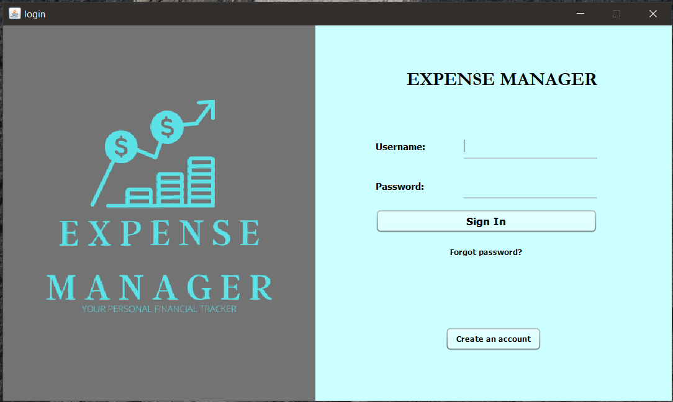
2.1 Proposed System
FrontEnd

Slide 12
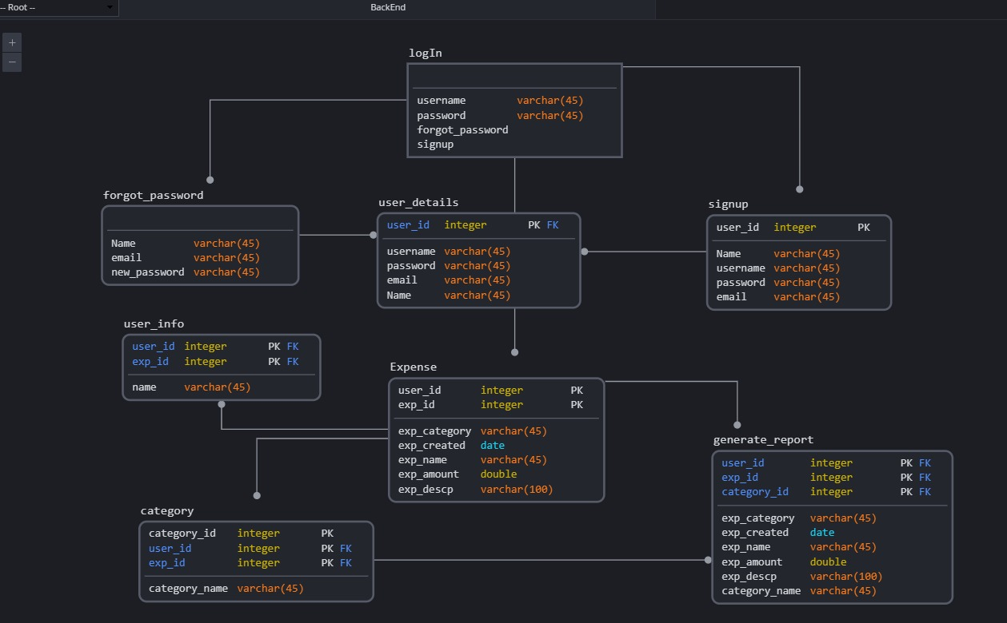
Backend

Slide 13
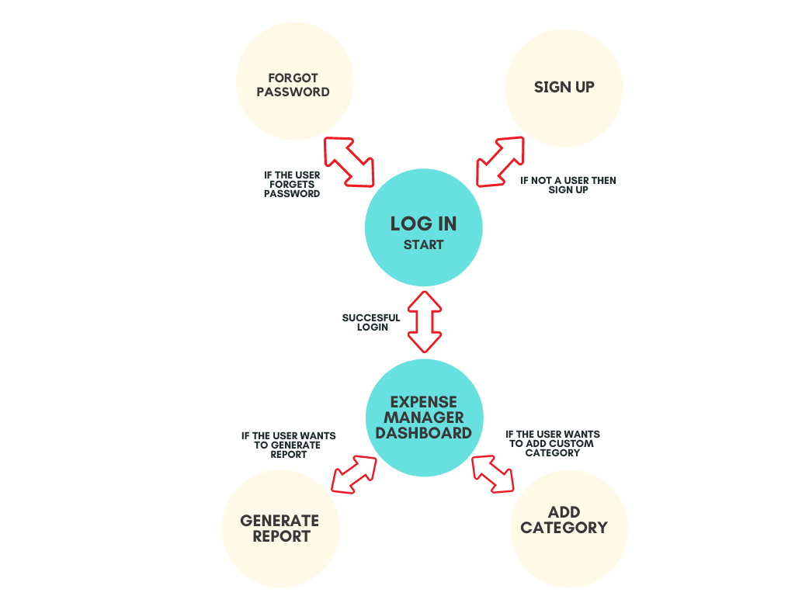
2.2 Design(Flow Of Modules)

Slide 14
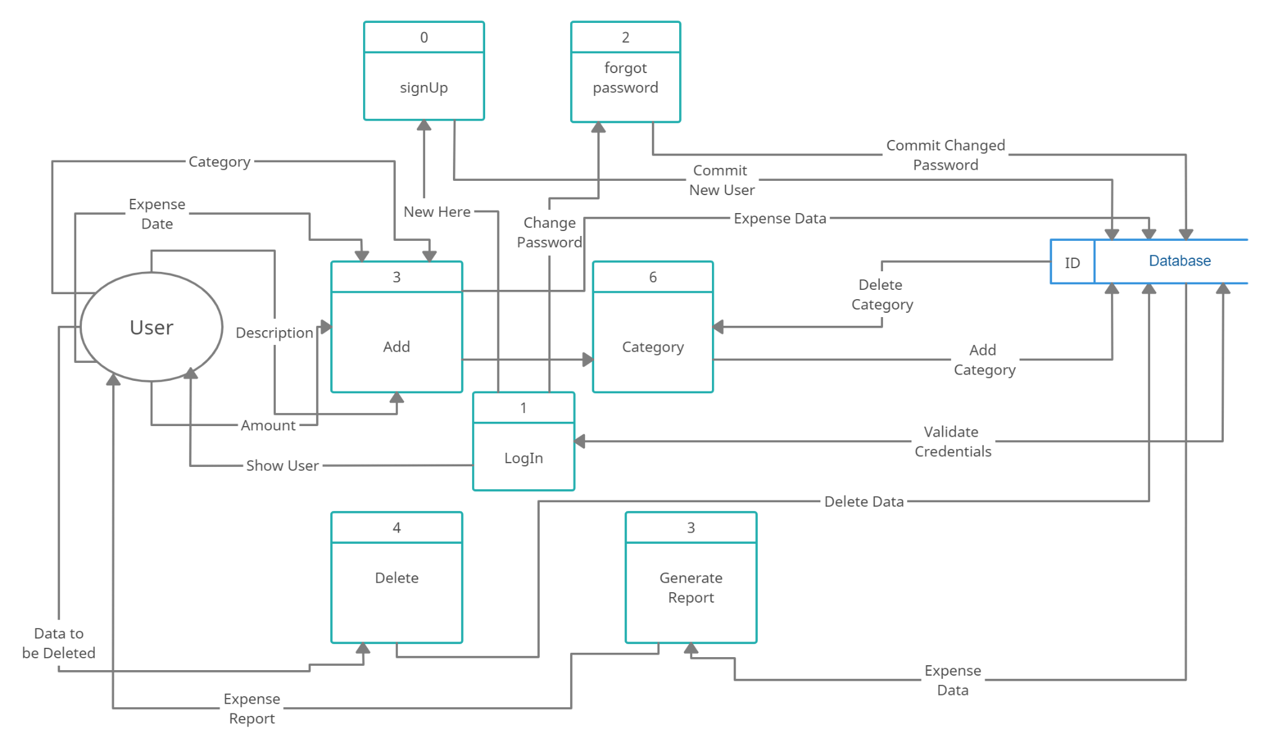
2.3 Data Flow Diagram

Slide 15
2.4 Module-1 : Login
The Login module is the main module that runs when the program is initiated and a Login page is presented consisting of the following things:
Username : The username will take the users credential for allowing him/her to use the expense manager.
Password : The password will give the username confirmation by checking the database entry for the same.
Sign in : The Sign in Button will act as an entry point to the dashboard of expense manager.
Forgot Password : The forgot password will help the user to reset the password for the user.
Create an account : The Create an Account button is for a new user to sign up and then use the expense manager.

Slide 16
Module-2 : Sign Up
The Sign Up page is called when the user clicks on “Create an Account” button on the Login page. It consist of the following things :
Name : The name of the user is taken for registering it in the database.
Username : The username allows the user to type his/her username.
Password and Confirm password : These option take and confirm the user’s password in database and are used next time when the user wants to login.
Email : The email-id of the user is taken to store in the database.

Slide 17
Module-3 : Forgot Password
The Forgot Password page helps the user to reset the password and help to Login again.
It takes Username and email to from the database to cross verify the user and then change the password.

Slide 18
Module-4 : Dashboard
The DashBoard module is called when the user click on “Sign in” in the login module. The Dashboard provides the User Interface screen of the expense manager to the user. It consists of the following things:
Current User
Date
Description
Amount
Category
Add Category
Refresh
Credit
Debit
Table
Delete
Logout

Slide 19
Module-5 : Category
When the Add Category button is clicked on the dashboard frame, the Category module is called and a new window is generated saying “Add New Category”, wherein a box category is provided to type the name of the category the user wants to save and then an “ADD” Button is provided to add the new category in the list.
A “Remove” Button at the bottom is the screen is also available if incase the user wants to discard any category

Slide 20
Module-6 : Report
When Report Button is clicked on the dashboard frame, The Report module is called and a new window is generated with the title “Report” on it. The following parameters are seen in the Report window:
From : The “from” box is used to take the date input from the user to know the “Start Date” of the report.
To : The “To” box is used to take the date input from the user to know the “End Date” of the report.
Category : The category is provided if in-case the user wants the report to be be generated for a particular category only.
The user can use various combinations to generate the report, for example:
The user can generate report on the basis of just Start date and End date.
The user can generate report on the basis of just Category.
The user can generate report on the basis of both Start date, End date and Category.

Slide 21
Module-7 : Db Class
The Db Class module is generated in order to establish automatic connection between java and the database, every time the Program runs.

Slide 22
3.Implementation
3.1 Platforms for Execution
3.2 Results

Slide 23
3.1 Platforms for execution
NetBeans
NetBeans is an integrated development environment (IDE) for Java. NetBeans allows applications to be developed from a set of modular software components called modules. NetBeans runs on Windows, macOS, Linux and Solaris.

Slide 24
3.2. Results

Slide 25
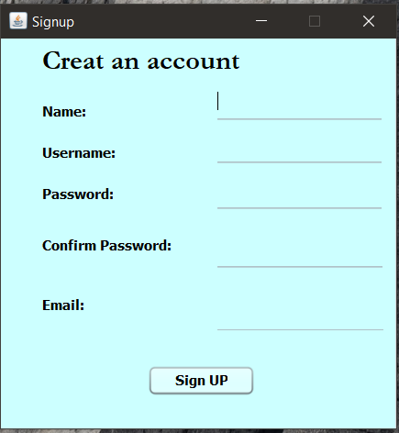
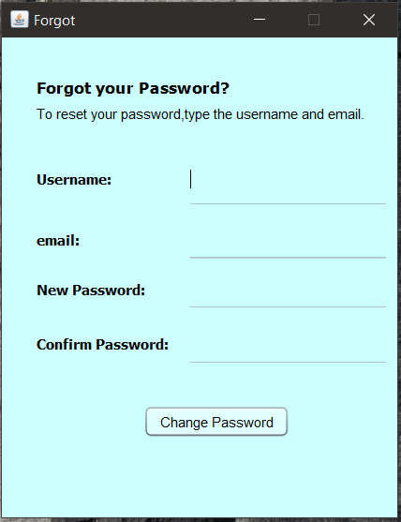

Slide 26
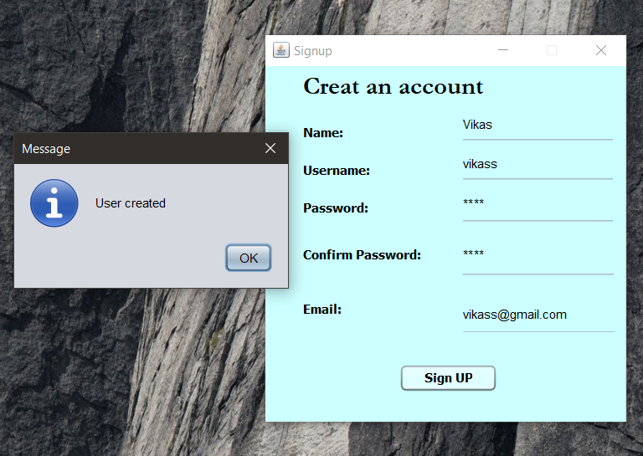
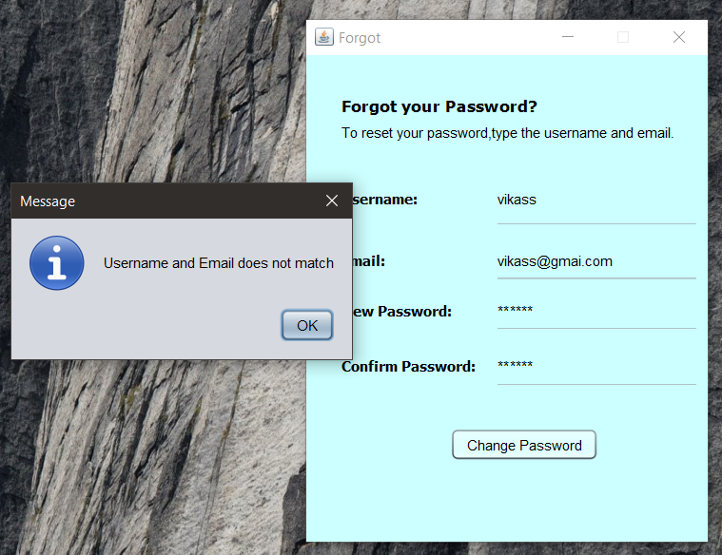
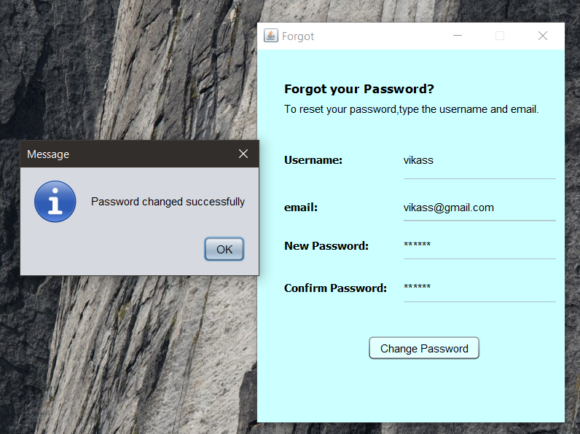

Slide 27
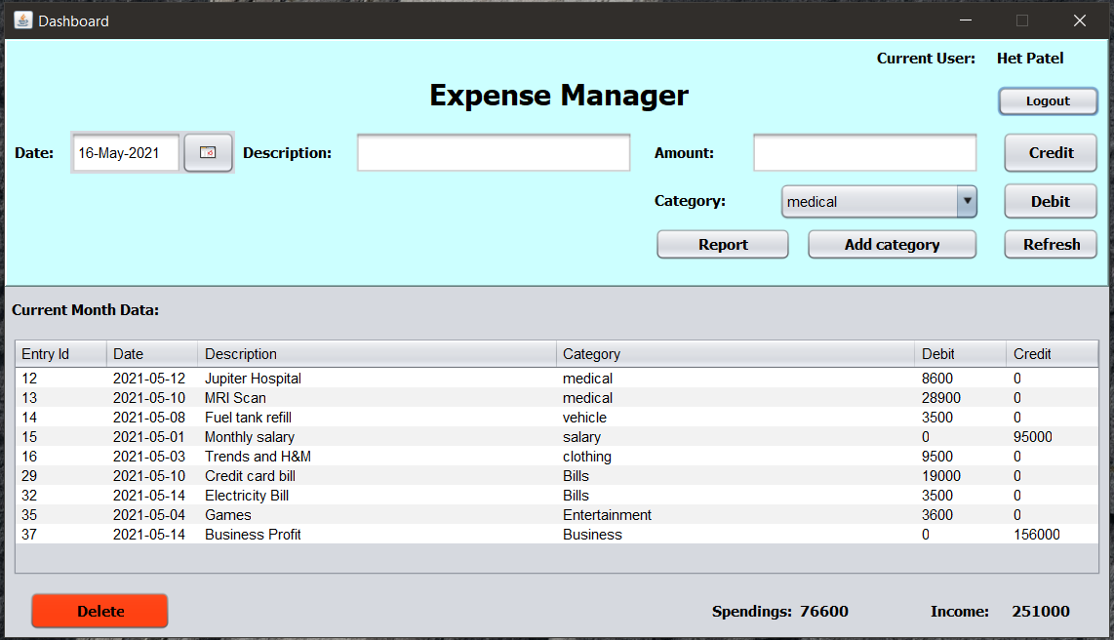
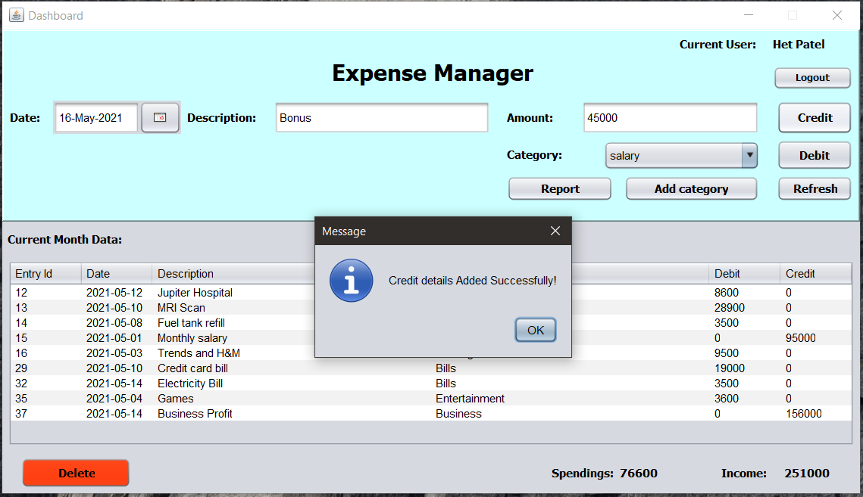
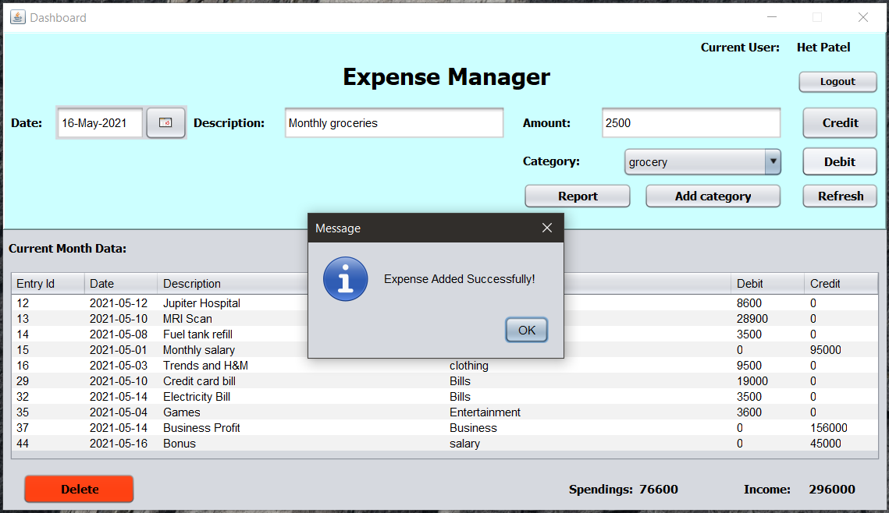
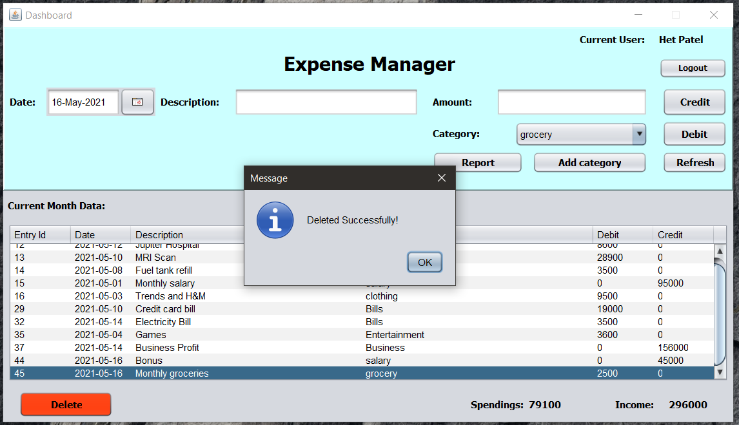

Slide 28
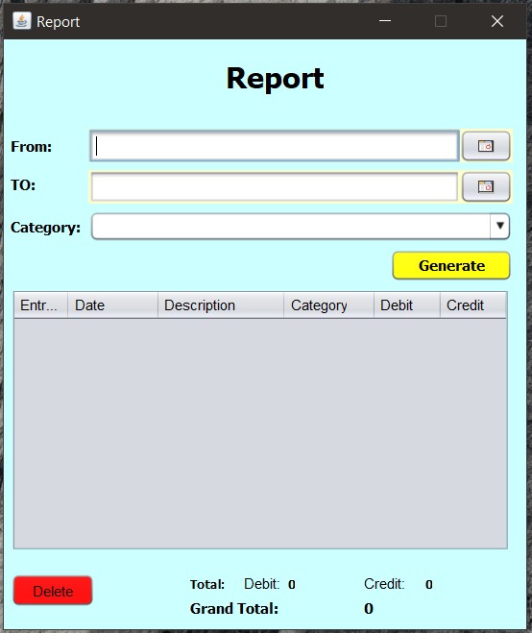
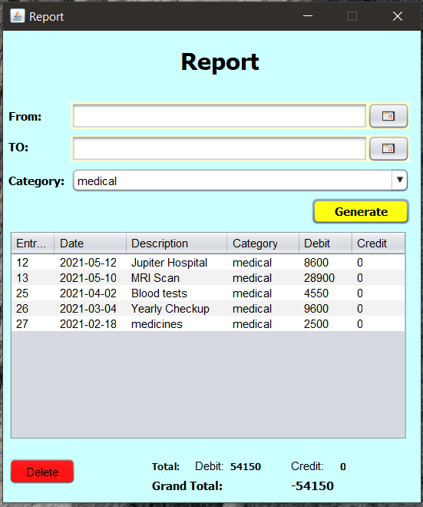

Slide 29
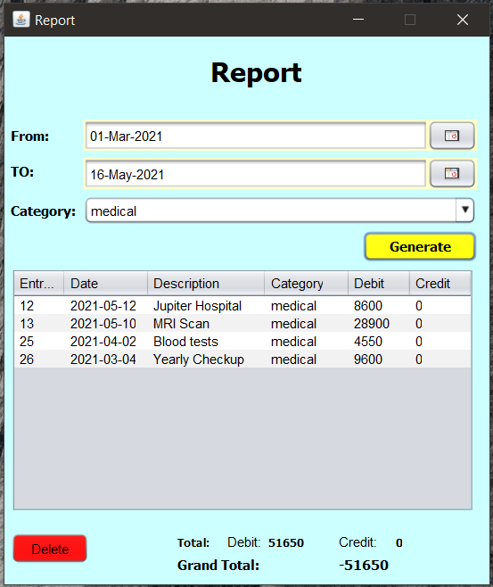

Slide 30
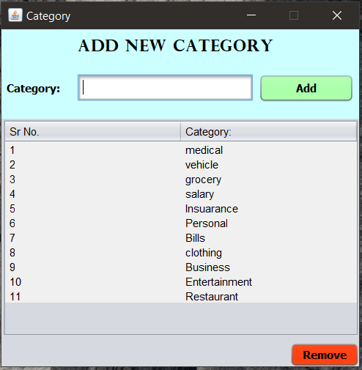
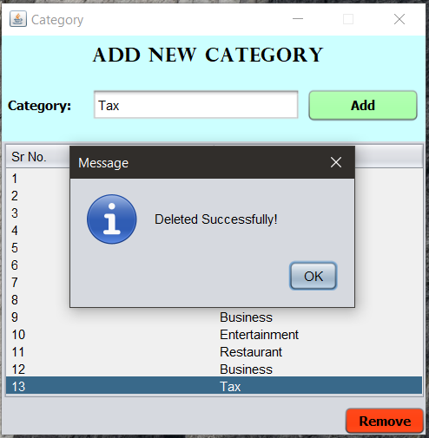
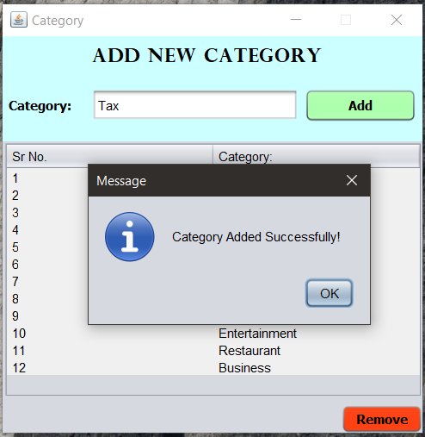

Slide 31
4.Conclusion and Future Scope
Conclusion :
The use of expense management software reduces the unnecessary effort of creating expense reports manually, collecting and verifying the receipts of each expense.
It can eliminate all these non-value adding activities, reducing the manual expense reporting time by 90%.
By Creating Expense Manager using Java for GUI and Mysql for database we conclude that we have learnt to use java swing and the use of tables for database.
Future Scope :
Converting it into a Mobile Application for user friendly and handy use.
Providing a HR view so that a company’s Expense on its employees and staff can be tracked.
A notification enabled system which will notify the user when He/She has very minimum balance.

Slide 32
5.Bibliography
[1] Digital Payments Induce Over-Spending: Evidence from the 2016 Demonetization in India
[Sumit Agarwal (National University of Singapore), Pulak Ghosh (Indian Institute of Management Bangalore), Jing Li (Singapore Management University), Tianyue Ruan (National University of Singapore

Slide 33
Thank You

